Slide 1





Introduction to Robotic Process Automation
AUTOREM: AUTOLOGIN AND ERP REMINDER
220701175
Muneesh P
Guide Name
Computer Science and Engineering

Slide 2
Abstract
The Autorem: AutoLogin and ERP Reminder project uses Robotic Process Automation (RPA) to simplify assignment management for students. It automates login to ERP systems, retrieves assignment deadlines, and sends timely email alerts to users, reducing the need for manual checks. The project also includes a user-friendly dashboard to provide a quick view of upcoming deadlines. By focusing solely on assignments, Autorem avoids distractions like fee updates and ensures data privacy, offering an efficient and lightweight solution for students.

Slide 3
Need for the Proposed System
In academic environments, students often face challenges in keeping track of multiple assignment deadlines within an institution's ERP system. Manually checking due dates and organizing reminders can be tedious and error-prone, leading to missed submissions and reduced academic performance. The proposed system, AutoRem, addresses these issues by automating ERP logins and sending timely email alerts for assignment deadlines. By streamlining this process, AutoRem ensures students stay updated effortlessly, reducing stress and improving time management. This automation supports the increasing reliance on digital tools in education, offering a practical solution for managing academic tasks efficiently and reliably.

Slide 4
Advantages of the Proposed System
Time Efficiency: Automates the ERP login process and deadline tracking, saving significant time for students.
Improved Organization: Ensures timely notifications for assignment deadlines, helping students manage tasks effectively.
Ease of Use: Simple to deploy and requires no technical expertise from users.
Scalability: Can be adapted to handle varying workloads and integrate with multiple ERP systems if needed.
Reliability: Operates consistently without manual intervention, ensuring uninterrupted alerts.
Stress Reduction: Reduces the mental load of remembering deadlines, allowing students to focus on academics.

Slide 5
Literature Survey
Paper 1: "Automated Reminder Systems for Academic Task Management" Summary: This paper examines the development of automated reminder systems aimed at helping students manage academic tasks, such as assignment deadlines and examination schedules. It evaluates the use of email and push notifications to provide timely alerts and discusses the integration of such systems with ERP platforms to enhance usability. The study highlights the importance of automation in improving student productivity and reducing missed deadlines. Advantages:
Streamlines academic task management by automating reminders.
Improves student compliance with deadlines through timely notifications.
Enhances productivity by reducing the need for manual tracking. Disadvantages:
Dependency on accurate ERP data for effectiveness.
Initial development and integration require significant technical effort.
Limited usability if students fail to check notifications regularly.

Slide 6
Literature Survey
Paper 2: "ERP Automation for Academic Institutions" Summary: This paper explores the integration of automation tools with ERP systems to address common challenges in managing academic workflows. It discusses the design of ERP automation modules that perform tasks like login automation, data retrieval, and task monitoring. Case studies demonstrate the system's ability to reduce manual effort and improve the reliability of task tracking. Advantages:
Automates repetitive actions like logging into ERP systems.
Increases efficiency by centralizing task tracking and reminders.
Reduces administrative workload, allowing focus on academic improvements. Disadvantages:
Requires frequent updates to adapt to changes in ERP system interfaces.
Dependence on internet connectivity for seamless operations.

Slide 7
Main Objective
The main objective of the AutoRem (AutoLogin and ERP Reminder) project is to automate the process of logging into the ERP system and tracking assignment deadlines. The system aims to provide timely email notifications to students about their pending tasks, reducing the effort and time required to manually check the ERP for updates. By streamlining this process, the project seeks to minimize missed deadlines, enhance time management, and improve academic performance. The ultimate goal is to create a reliable, efficient, and user-friendly solution that helps students stay organized and focus on their studies without the burden of manual task tracking.

Slide 8
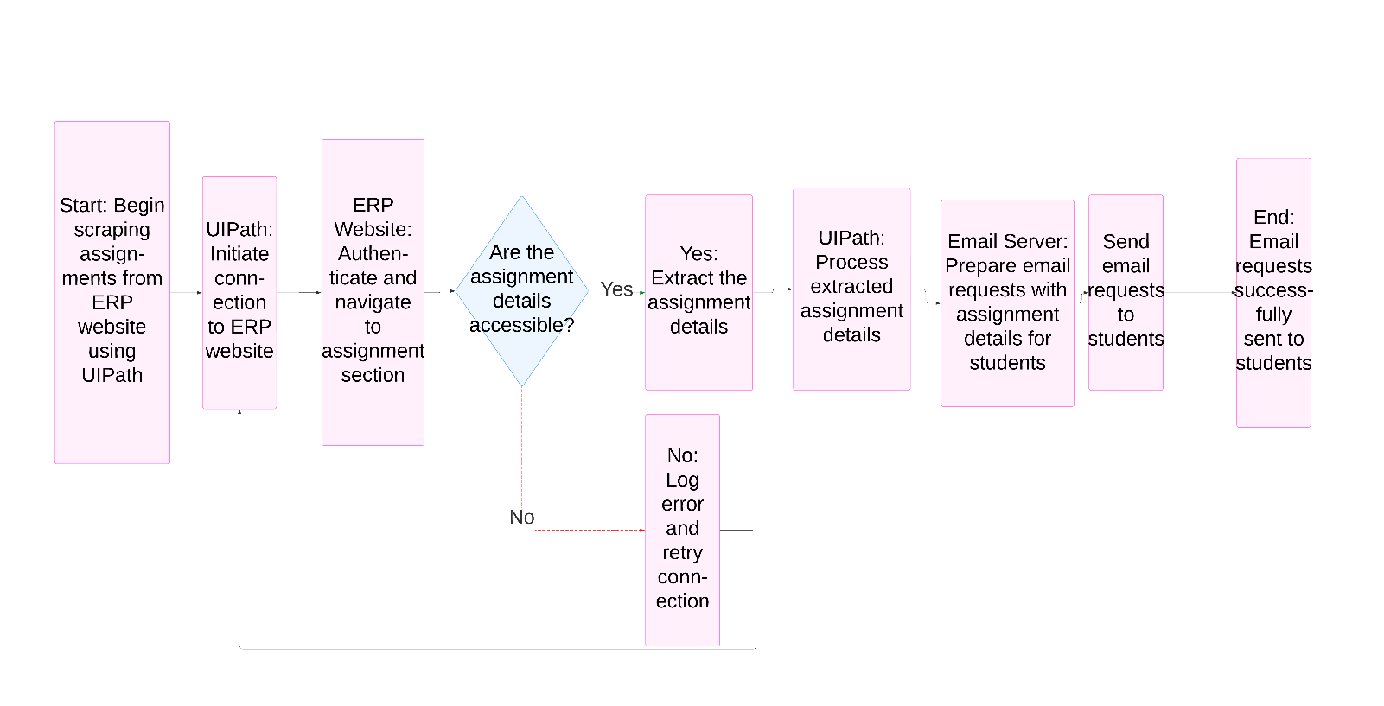
Architecture

Slide 9
System Requirements
Hardware Requirements:
-Processor: Intel i3 or higher (recommended Intel i5 or above).
-RAM: Minimum 4 GB (8 GB recommended for smoother performance).
-Storage: At least 5 GB of free space for installation and temporary data storage.
-Internet: Stable connection for accessing the ERP system and sending email notifications.
Software Requirements:
-Browser: Google Chrome or Mozilla Firefox with the Selenium WebDriver installed.
-Email Service: Gmail account configured for SMTP for sending notifications.

Slide 10
Functional Description
Module 1: ERP Data Extraction and Processing In this module, the objective is to automate the retrieval of assignment-related data from the institution’s ERP system. The process involves logging into the ERP, navigating to the relevant sections, and extracting details such as assignment titles, deadlines, and statuses. This data is then processed to ensure it is formatted appropriately for notification purposes. Key tasks include:
Automated Login: Using scripts to securely log into the ERP system without manual intervention.
Data Extraction: Identifying and collecting assignment-related data from the ERP system.
Data Validation: Verifying the extracted data for completeness and ensuring that deadlines and assignment details are accurate.

Slide 11
Functional Description
Module 2: Email Notification and Reminder System This module focuses on automating the process of notifying students about upcoming assignment deadlines through email. Once the processed data is ready, the system generates personalized reminders and sends them via email using SMTP. Key tasks include:
Email Content Generation: Creating clear and concise email messages that include assignment details, deadlines, and links to relevant resources.
Automated Email Dispatch: Configuring and using SMTP to send emails to the students automatically at scheduled intervals.
Scheduling Notifications: Setting up task schedulers or cron jobs to send reminders at regular intervals, ensuring students are consistently updated.

Slide 12
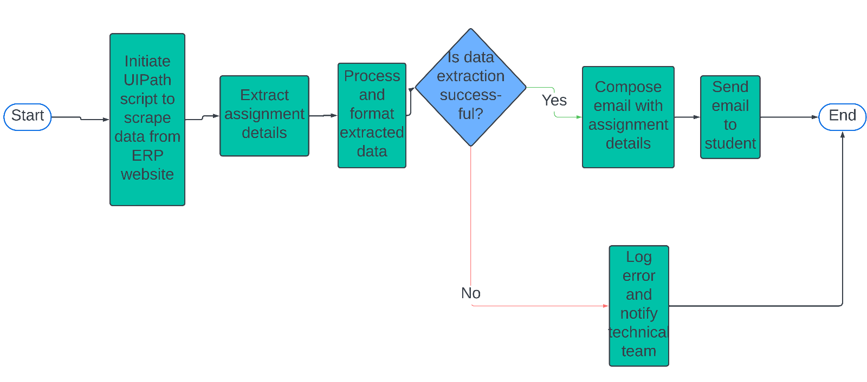
Functional Description
Activity Diagram

Slide 13
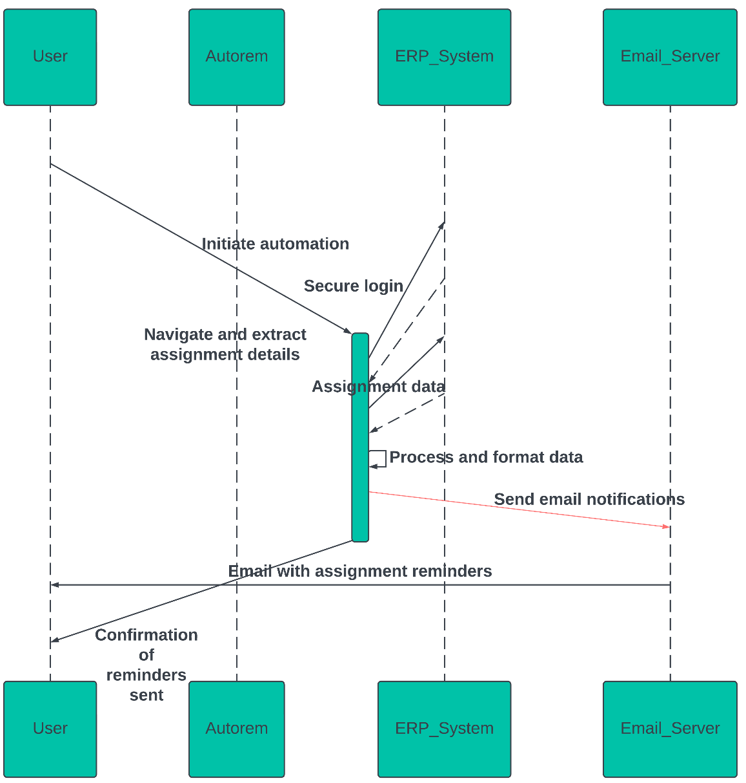
Table Design
Entity Relationship Diagram

Slide 14
Process Design
Process 1: ERP Data Extraction and Processing
Login Automation:
Use UiPath's Web Automation activities to open the ERP system's login page.
Use the Get Text or Screen Scraping activities to verify successful login.
Data Retrieval:
Access the assignments section using automated navigation.
Scrape assignment details like titles, deadlines, and statuses.
Data Validation and Processing:
Validate extracted data to check for completeness and remove duplicates.
Format deadlines and sort assignments by urgency.

Slide 15
Process Design
Process 2: Email Notification System
Email Configuration:
Configure the Gmail or SMTP email settings in UiPath using the Send SMTP Mail Message activity.
Use the sender’s email credentials stored in Orchestrator or in a secure way.
Email Content Generation:
Use Assign activities to generate personalized email content by mapping the assignment data (e.g., title, deadline) to placeholders.
Create dynamic email bodies with String.Format to ensure that each email includes relevant assignment information.
Email Dispatch:
Use the Send SMTP Mail Message activity to automatically send personalized emails to students.
Use Log Message activity to log successful email dispatch & errors.

Slide 16
Implementation
Module 1: Initialize and Setup
The "Initialize and Setup" module sets up the environment for AutoRem’s automated data extraction and email notification system. In this stage, essential variables are initialized, such as the ERP login credentials (username and password), the URL of the assignments section, and the SMTP settings for email notifications. UiPath opens the browser to log into the ERP system and navigate to the assignments page. This module ensures that all configurations, including file paths for assignment data, email credentials, and necessary libraries, are correctly initialized to prevent errors in subsequent steps. It prepares the system for secure login, data extraction, and email dispatch.

Slide 17
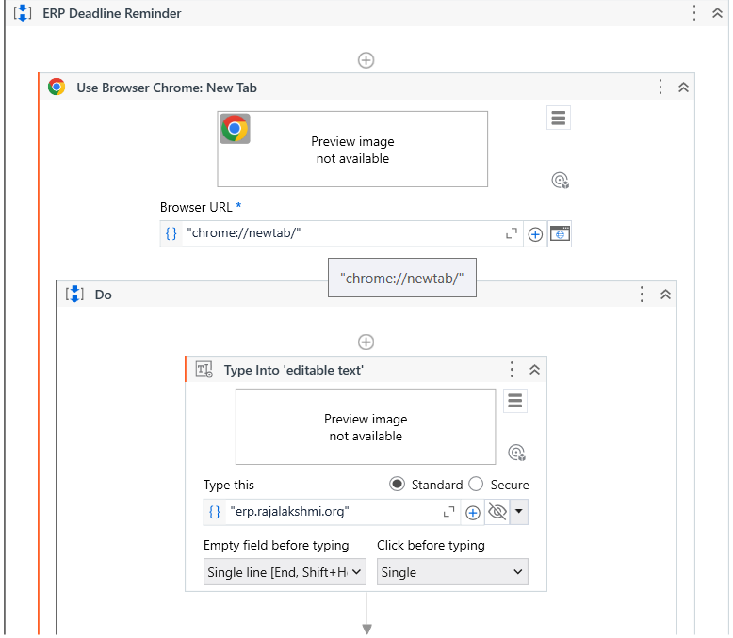
Implementation
Screen Shots

Slide 18
Implementation
Module 2: Data Extraction and Email Notification
In this module, UiPath automates the extraction of assignment data from the ERP system. After logging into the ERP and navigating to the assignments section, the workflow uses UiPath's Data Scraping or Get Text activities to retrieve assignment titles, deadlines, and submission statuses. The data is validated and stored in a structured format (e.g., DataTable). Then, using the For Each Row activity, UiPath generates personalized email content for each student, mapping the assignment data to the email template. Finally, the Send SMTP Mail Message activity is used to send the email notifications to students, ensuring they receive timely reminders.

Slide 19
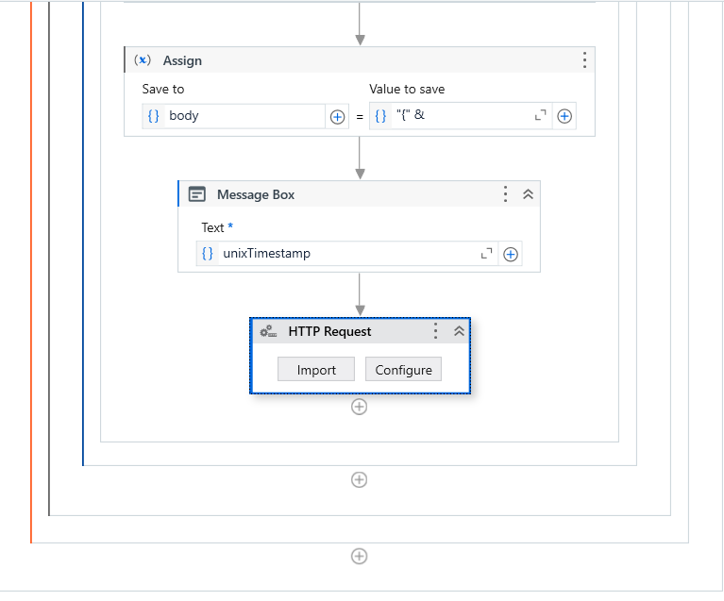
Implementation
Screen Shots

Slide 20
Testing
Testing of the AutoRem Project
Testing of the "AutoRem" project involves key stages to ensure smooth operation. Unit testing is first conducted on each individual task, such as ERP login automation, data extraction, and email dispatch. This ensures that login credentials are entered correctly, assignment data is retrieved accurately, and emails are generated properly.
Next, integration testing is performed to ensure that all components work together seamlessly. This includes verifying that the data flows correctly from ERP extraction to email notification. Any issues, such as incorrect data mapping or email formatting, are identified and resolved, ensuring the entire process works without errors.

Slide 21
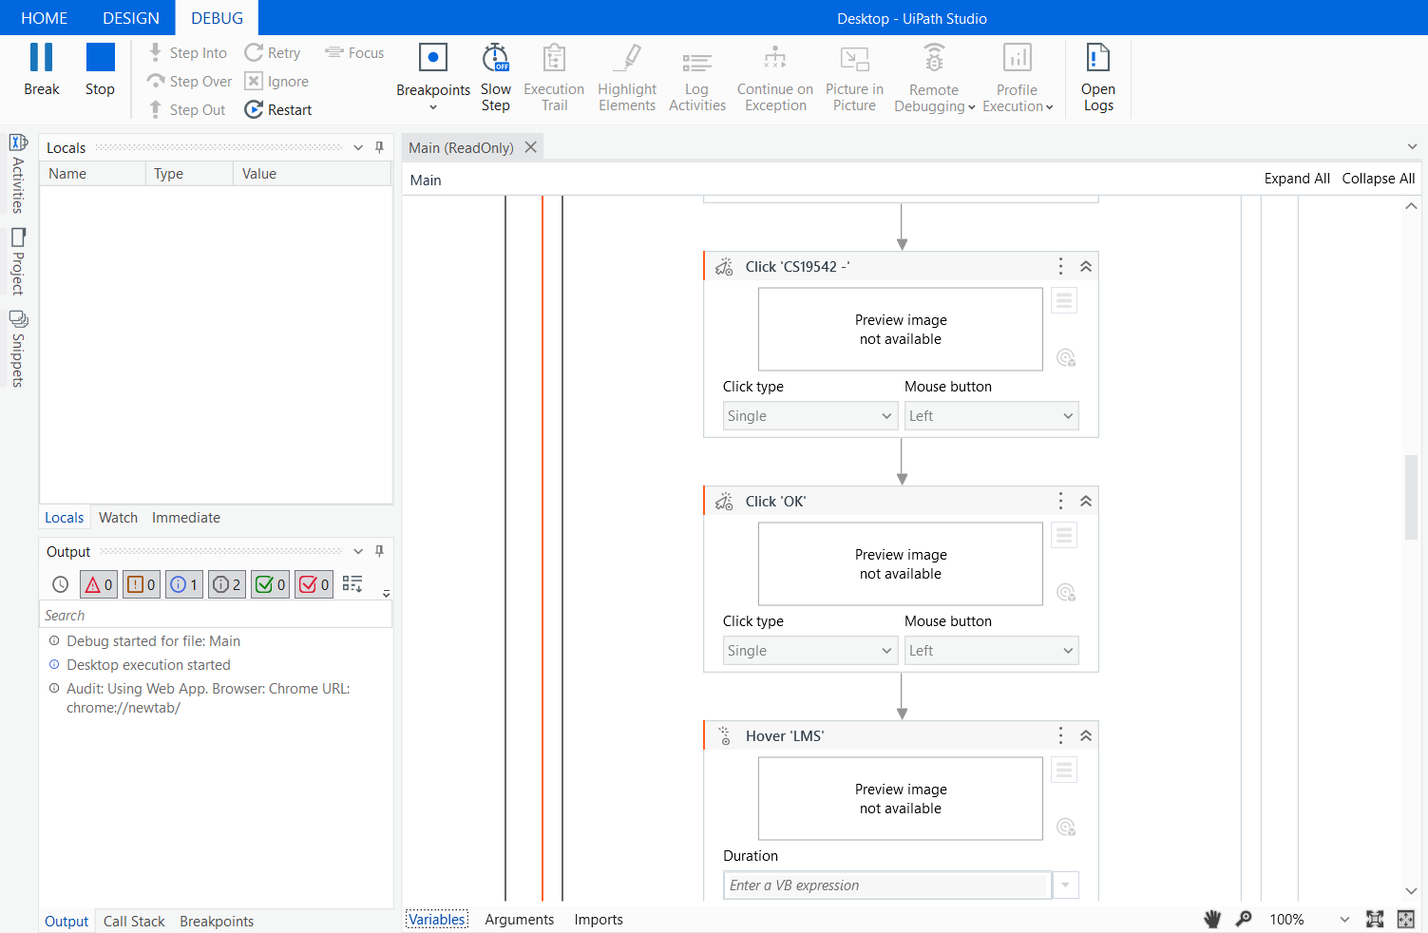
Testing
Screen Shots

Slide 22
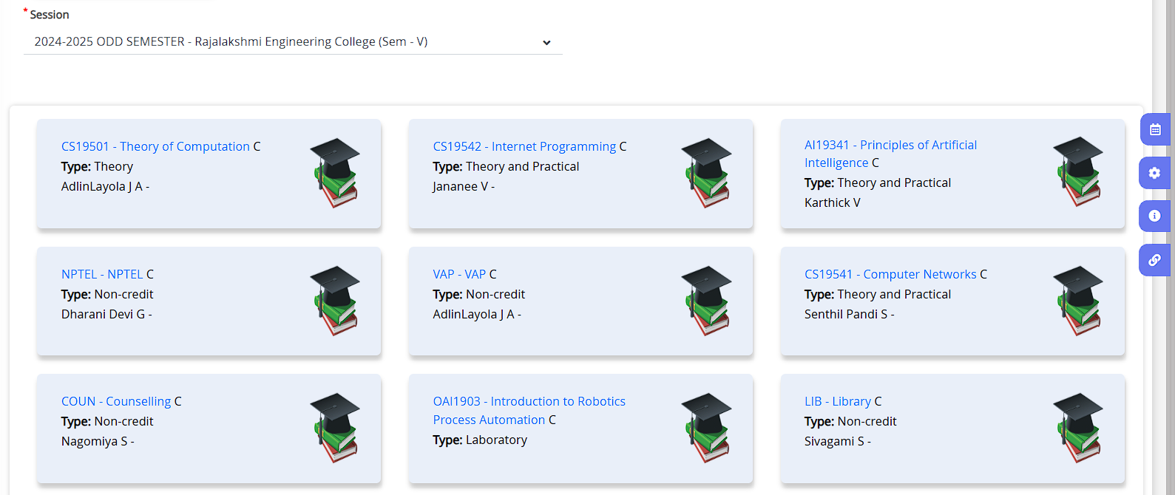
Testing
Screen Shots

Slide 23
Conclusions
The "AutoRem" project effectively showcases the power of UiPath in automating assignment tracking and email notification processes. By automating data extraction from the ERP system and sending personalized email reminders to students, the project reduces manual effort and ensures timely communication. Through comprehensive testing, the system was optimized to handle various data formats and ensure reliable email dispatch, making it scalable for larger institutions. The project demonstrates the potential of Robotic Process Automation (RPA) in improving administrative workflows, saving time, and enhancing productivity. This automation can be extended to other administrative tasks, highlighting its applicability across various sectors.

Slide 24
Future Enhancement
Future Enhancement 1: Web-Based Notification System A key future enhancement for AutoRem is the development of a web-based notification system to streamline assignment tracking and deadline management. This enhancement would involve creating a user-friendly webpage where students can register with their email addresses and receive personalized notifications about their assignments. By integrating with Google’s Gmail service, the system would send automatic email notifications whenever new assignments are posted, ensuring that students stay on top of deadlines. The web platform would feature an intuitive interface for profile management, updating details, and customizing notification preferences, catering to the individual needs of students while remaining simple to use.

Slide 25
Future Enhancement
Future Enhancement 2: Deadline Reminder Alerts
In addition, the system would send timely alerts when assignments are nearing their due dates, preventing students from overlooking important tasks. It could include a centralized dashboard displaying all assignments with details like the name, due date, and a countdown timer. The dashboard would update in real-time as assignments are posted or modified. Automated Gmail notifications would act as a non-intrusive reminder, helping students manage their academic duties efficiently. This enhancement would transform AutoRem into a comprehensive assignment management solution, improving the overall academic experience for students.

Slide 26
IEEE Paper
Title 1: Automation of Assignment Management Using Web-Based Notification Systems Authors: Sarah Williams, David Clark, and Mark Thompson
Title 2: Robotic Process Automation for Automated Student Dashboard and Deadline Notifications Authors: Emily Roberts, James Lee, and Olivia Turner

Slide 27
References
1.UiPath Official Documentation. (n.d.). Robotic Process Automation (RPA) Overview. Retrieved from https://www.uipath.com
2.Jain, S., & Bhutani, S. (2020). Robotic Process Automation (RPA): A Literature Review and Implementation in Business Processes. International Journal of Advanced Research in Computer Science and Software Engineering, 10(7), 42-47.
3.Huang, K. T., & Lee, R. W. (2021). Automation of Social Media Management Using Robotic Process Automation (RPA).
4. Brown, G. (2020). The Future of Automation in Business Processes: A Focus on RPA Tools. Springer International Publishing.
5. Bhatnagar, A. (2021). Optimizing Business Workflows with UiPath RPA: A Comprehensive Guide. Wiley Publishing.

Slide 28
Queries

Slide 29
Demonstration

Slide 30
Thank You

